Slide 1
Chapter 4
Return and Risk

Slide 2
Return and Risk
Learning Goals
Review the concept of return, its components, the forces that affect the level of return, and historical returns.
Discuss the role of time value of money in measuring return and defining a satisfactory investment.
Describe real, risk-free, and required returns and the calculation and application of holding period return.
Explain the concept and calculation of an internal rate of return and how to find growth rates.
Discuss the key sources of risk that might affect potential investments.
Understand the risk of a single asset, risk assessment, and the steps that combine return and risk.

Slide 3
The Concept of Return
Return: the level of profit from an investment—that is, the reward for investing.
Components of Return
Why Return is Important
Level of Return
Historical Returns
The Time Value of Money and Returns

Slide 4
The Concept of Return
Components of Return
Income: cash that investors periodically receive as a result of owning an investment.
Capital Gains (or Losses): the difference between the proceeds from the sale of an investment and its original purchase price.
Total Return: the sum of the income and the capital gain (loss) earned on an investment over a specified period of time.

Slide 5
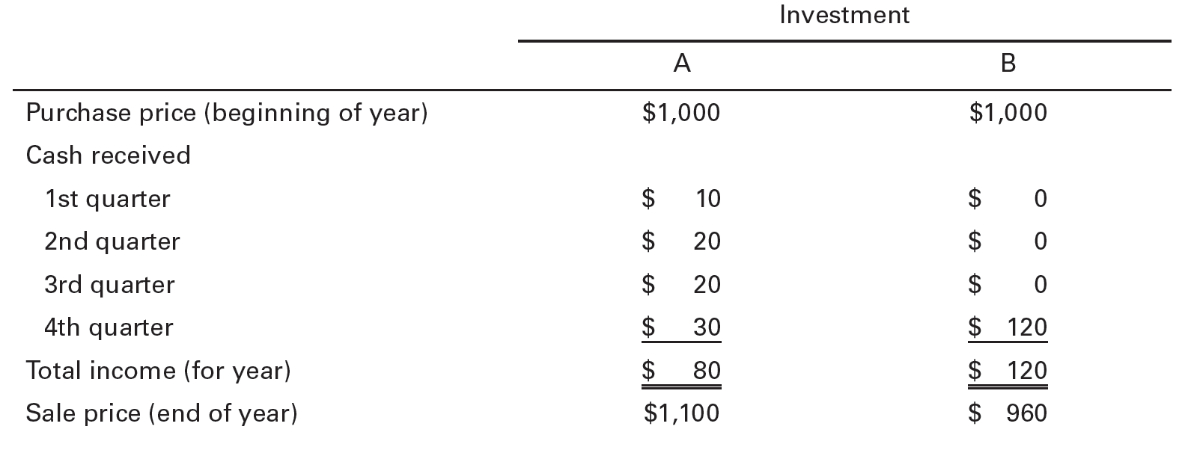
Table 4.1 Profiles of Two Investments

Slide 6
Table 4.2 Total Returns of Two Investments

Slide 7
The Concept of Return
Why Return is Important
The rate of return indicates how rapidly an investor can build wealth.
Historical Performance
Provides a basis for future expectations
Does not guarantee future performance
Expected Return
Return an investor thinks an investment will earn in the future
Determines what an investor is willing to pay for an investment or if they are willing to make an investment

Slide 8
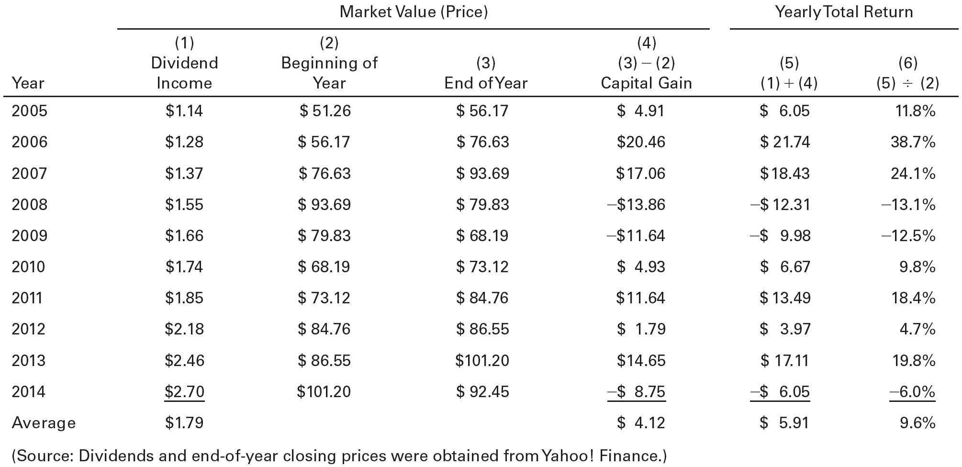
Table 4.3 Historical Investment Data for ExxonMobil Corp. (XOM)

Slide 9
The Concept of Return
Level of Return
Internal characteristics
Type of investment (e.g., stocks or bonds)
Quality of the firm’s management
Whether the firm finances its operations with debt or equity
External Forces
Political environment
Business environment
Economic environment
General level of price changes:
Inflation (Deflation): up (down)
Generally speaking, when investors expect inflation to occur, they demand higher returns.
The way that investment returns respond to unexpected changes in inflation will vary by type of investment, and that response can be influenced by investors’ beliefs about how policymakers will react to changing inflation.

Slide 10
The Concept of Return
Historical Returns
Returns vary over time and by type of investment
Significant differences exist among the average annual rates of return realized on stocks, long-term government bonds, and short-term government bills

Slide 11
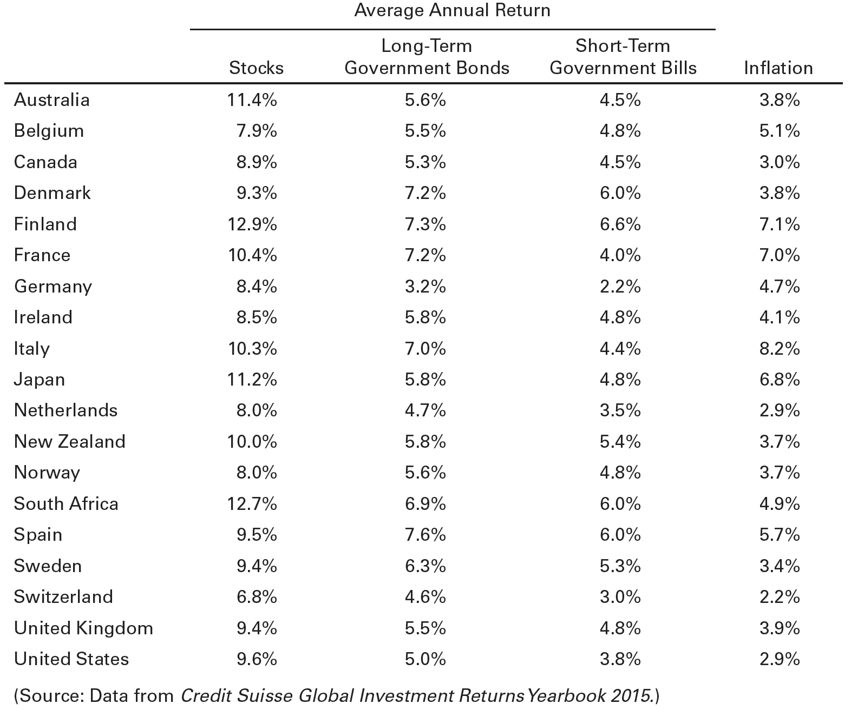
Table 4.4 Historical Returns for Major Asset Classes (1900-2014)

Slide 12
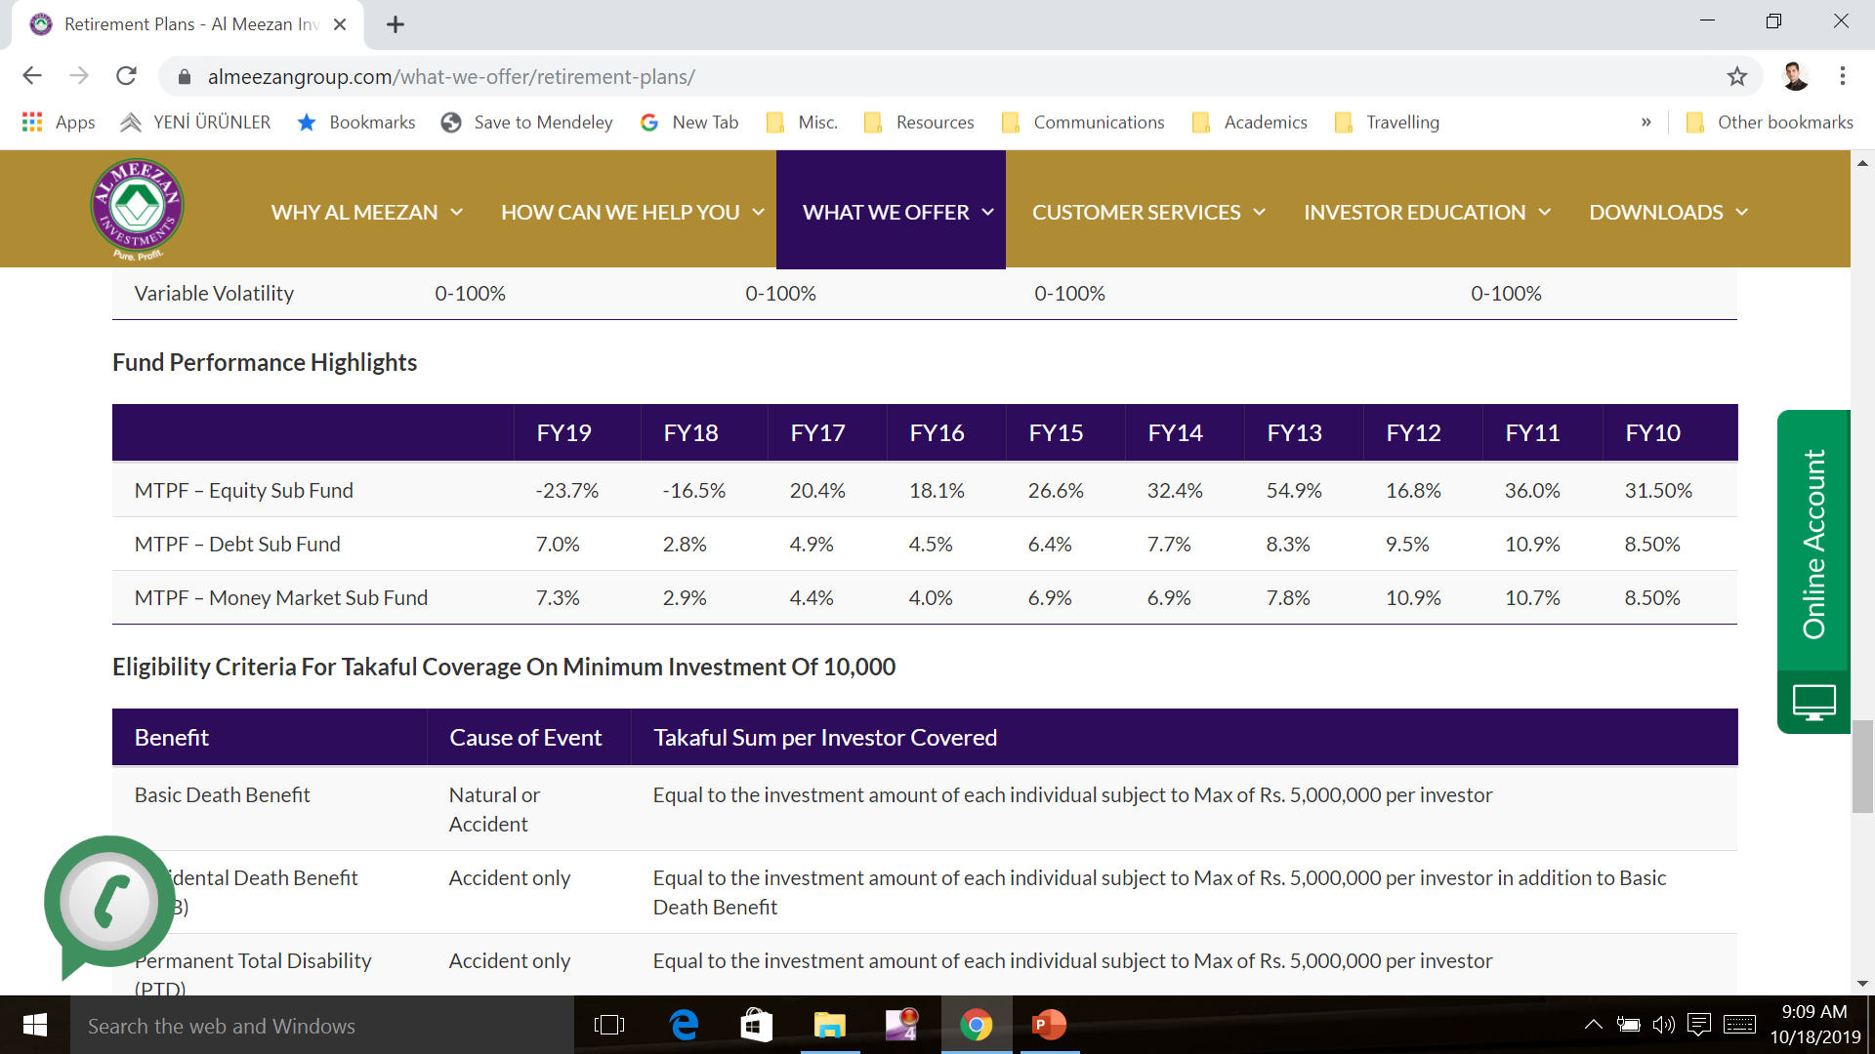
Meezan Tahaffuz Pension Fund

Slide 13
The Concept of Return
The Time Value of Money and Returns
Time value of money: It is generally better to receive cash sooner rather than later
Computational Aids for Use in Time Value of Money Calculations
Financial calculators
Electronic spreadsheet

Slide 14
The Concept of Return
The Time Value of Money and Returns
Determining a Satisfactory Investment
Satisfactory investment: one for which the present value of benefits (discounted at the appropriate discount rate) equals or exceeds the present value of its costs.
If the present value of the benefits equals the cost, you earn a rate equal to the discount rate
If the present value of the benefits exceeds the cost, you earn a rate of return greater than the discount rate.
If the present value of the benefits is less than the cost, you earn a rate of return less than the discount rate.

Slide 15
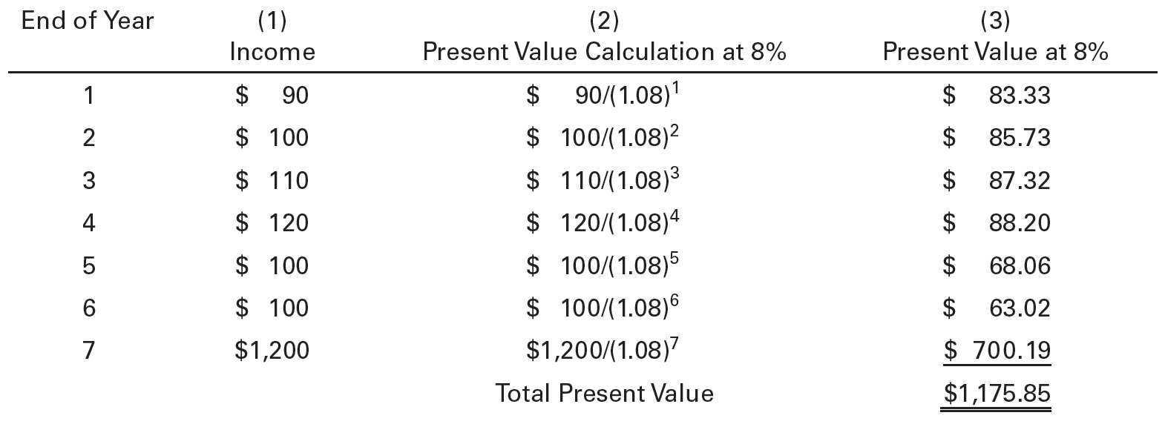
Table 4.5 Present Value Applied to an Investment

Slide 16
Measuring Return
There are several measures that enable us to compare alternative investments.
To compare returns from different investments, we need to incorporate time value of money concepts that explicitly consider differences in the timing of investment income and capital gains.
Expected Return
Real, Risk-Free, and Required Returns
Holding Period Return
The Internal Rate of Return
Finding Growth Rates

Slide 17
Measuring Return
Expected Return
Calculating the Expected Return from an Investment

Slide 18
Measuring Return
Real, Risk-Free, and Required Returns
Inflation and Returns
Nominal Rate of Return: the return that the investment earns expressed in current dollars. It does not take into account the effects of inflation.
Real Rate of Return: measures the increase in purchasing power that the investment provides.
Approximately equals the nominal rate of return minus the inflation rate:
Real Return ≈ Nominal Return – Inflation Rate

Slide 19
Measuring Return
Real, Risk-Free, and Required Returns
Risk and Returns
Investors are generally risk averse: they do not like risk and will only take risk when they expect compensation for doing so.
Required Return: the rate of return that fully compensates for an investment’s risk

Slide 20
Measuring Return
Real, Risk-Free, and Required Returns
Risk and Returns
Expected inflation premium: the rate of inflation expected over an investment’s life
Risk-free rate: rate of return that can be earned on a risk-free investment, such as a short-term U.S. Treasury bill.

Slide 21
Measuring Return
Real, Risk-Free, and Required Returns
Risk and Returns
Risk premium: Additional return an investor requires on a risky investment to compensate for risks based upon issue and issuer characteristics.
Issue characteristics are the type, maturity and features
Issuer characteristics are industry and company factors

Slide 22
Measuring Return
Holding Period Return
Holding period: the period of time over which one wishes to measure the return on an investment.
Understanding Return Components
Realized Return: income received by the investor during the investment period
Paper Return: the capital gain or loss that has been achieved but not yet realized (no sale has taken place)

Slide 23
Measuring Return
Holding Period Return
Computing the Holding Period Return
Holding Period Return (HPR): the total return earned from holding an investment for a specified time (the holding period); usually one year or less.
Using the HPR in Investment Decisions
HPR offers a relative comparison, by dividing the total return by the amount of the investment.

Slide 24
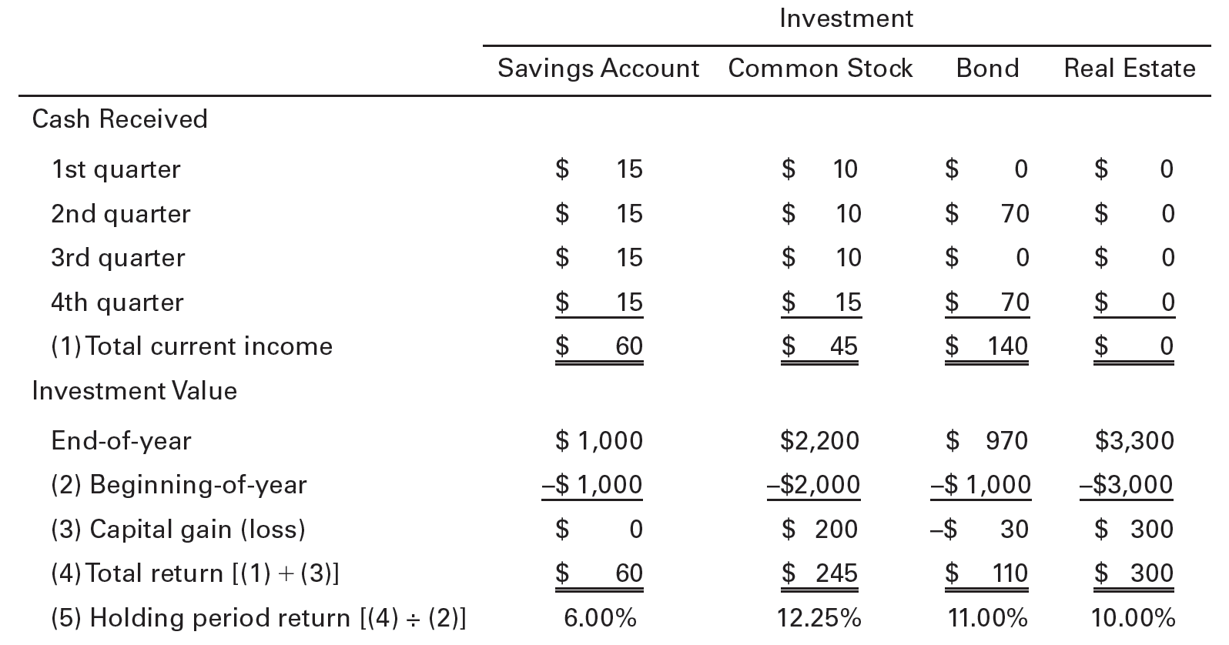
Table 4.6 Key Financial Variables for Four Investments

Slide 25
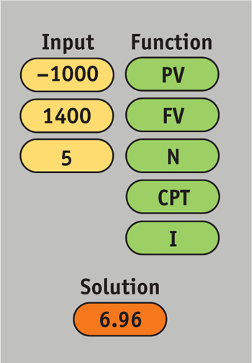
Measuring Return
The Internal Rate of Return
Internal Rate of Return: The discount rate that equates an investment’s cost to the present value of the benefits that it provides for the investor.
IRR for a Single Cash Flow
E.g., investments such as U.S. savings bonds, stocks paying no dividends, and zero-coupon bonds, that provide no periodic income.
Example: What is the yield (IRR) on an investment costing $1,000 today that you expect will be worth $1,400 at the end of a 5-year holding period?

Slide 26
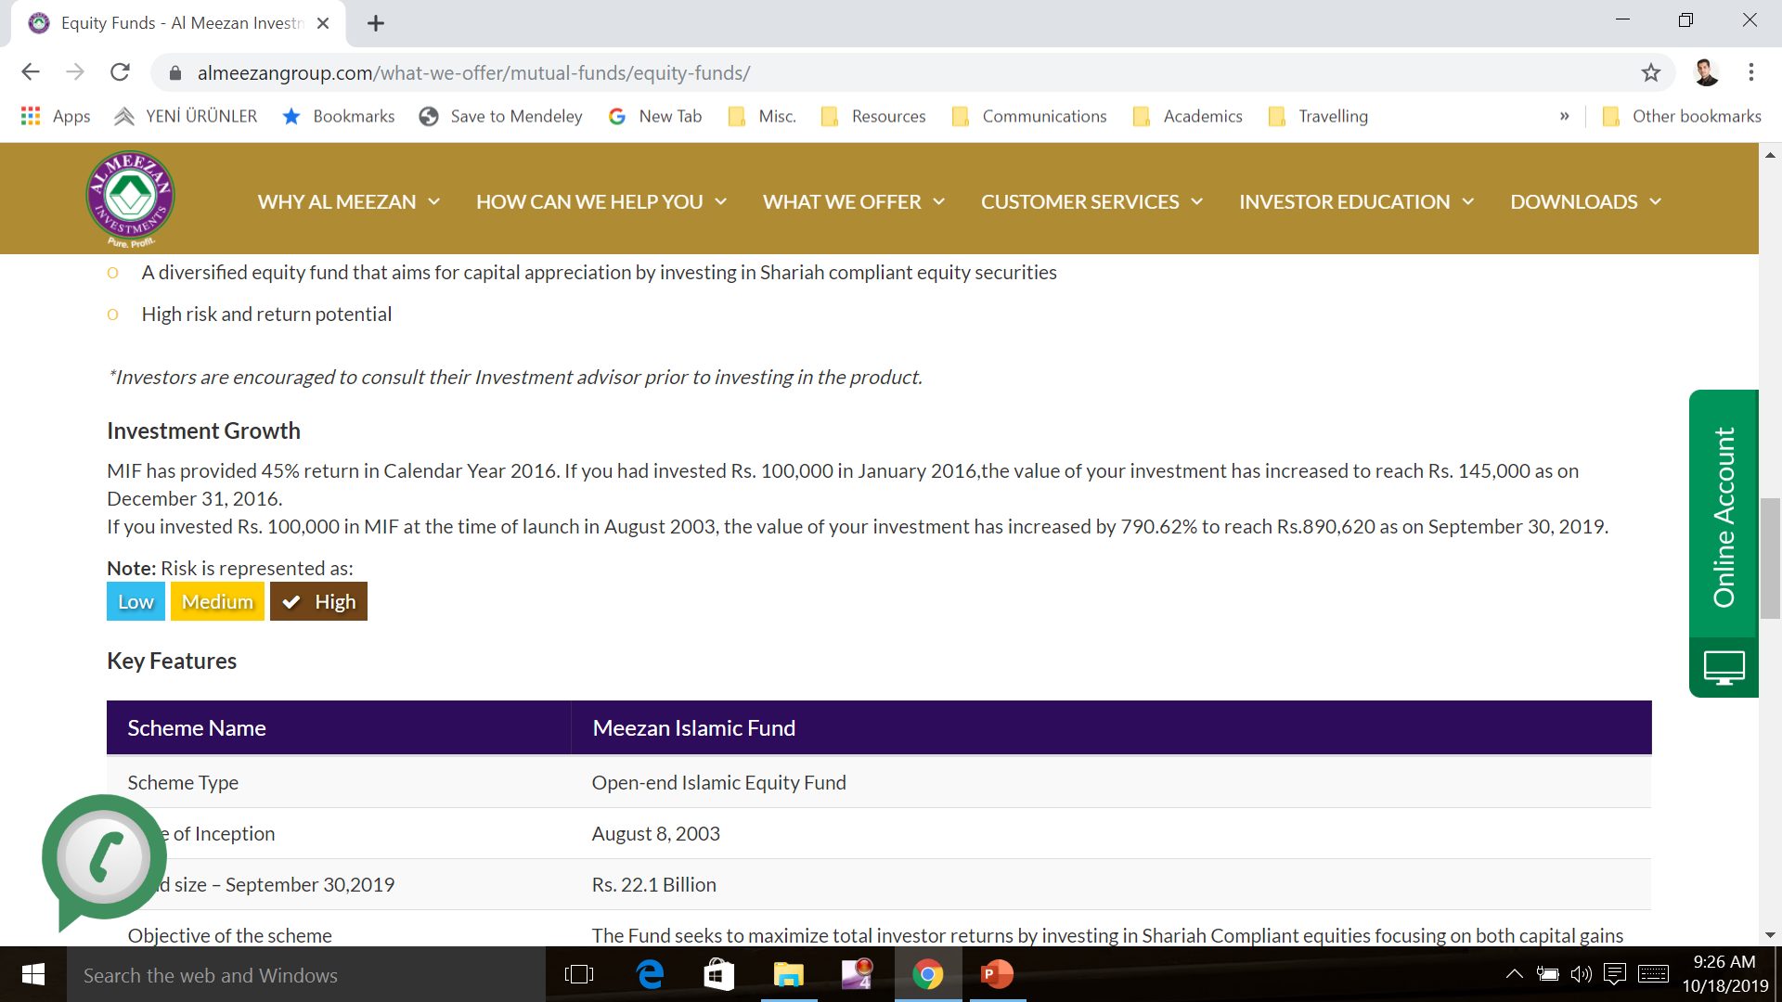
Meezan Equity Fund Performance
Notes:
They show that your investment will increase by 790.62%. However when you calculate IRR using the financial calculator, it is 14.65% which is very close to interest rate of around 13% offered by the National Savings in Pakistan.

Slide 27
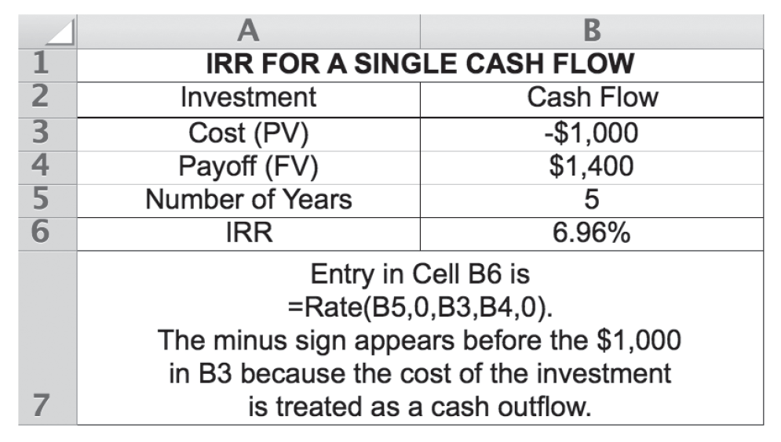
Measuring Return

Slide 28
Measuring Return
The Internal Rate of Return
IRR for a Stream of Income
Investments such as income-oriented stocks and bonds typically provide the investor with an income stream.
The IRR on an investment that pays income periodically is the discount rate that equates the present value of the investment’s cash flows to its current price.

Slide 29
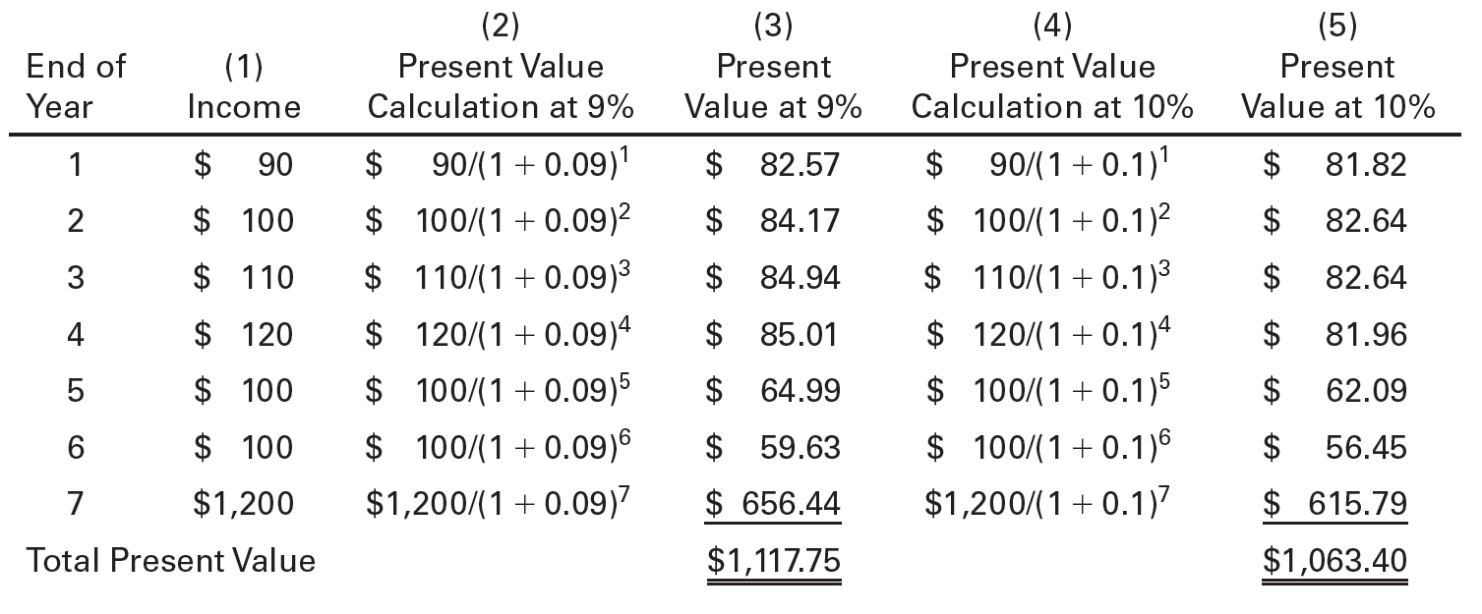
Table 4.7 Present Value Applied to an Investment

Slide 30
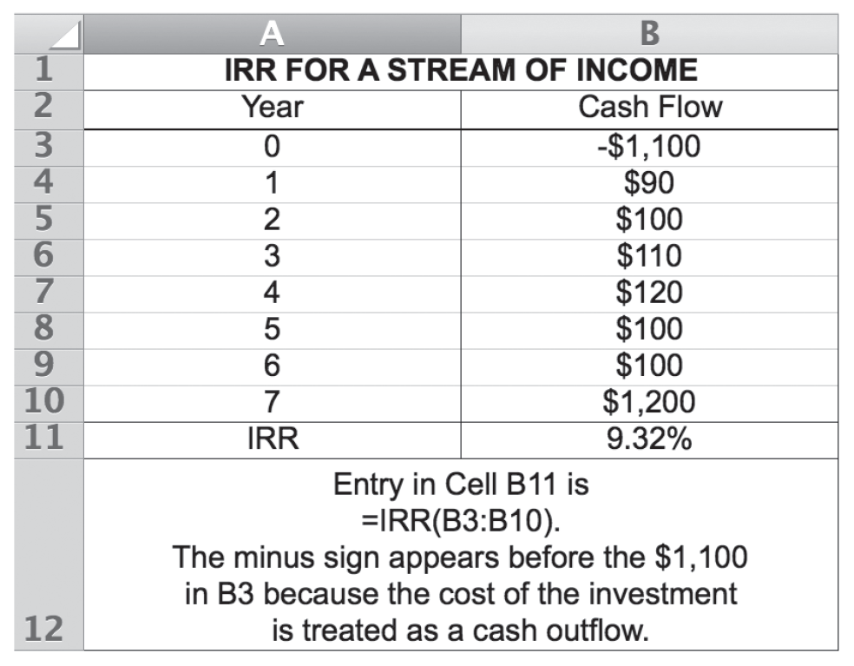
Measuring Return

Slide 31
Measuring Return
The Internal Rate of Return
Interest on Interest: The Critical Assumption
Using IRR to measure return assumes that all income earned over the investment horizon is reinvested at the same rate as the original investment.
Reinvestment Rate: the rate of return earned on interest or other income received from an investment over its investment horizon.
Fully compounded rate of return: is the rate of return that includes interest earned on interest.

Slide 32
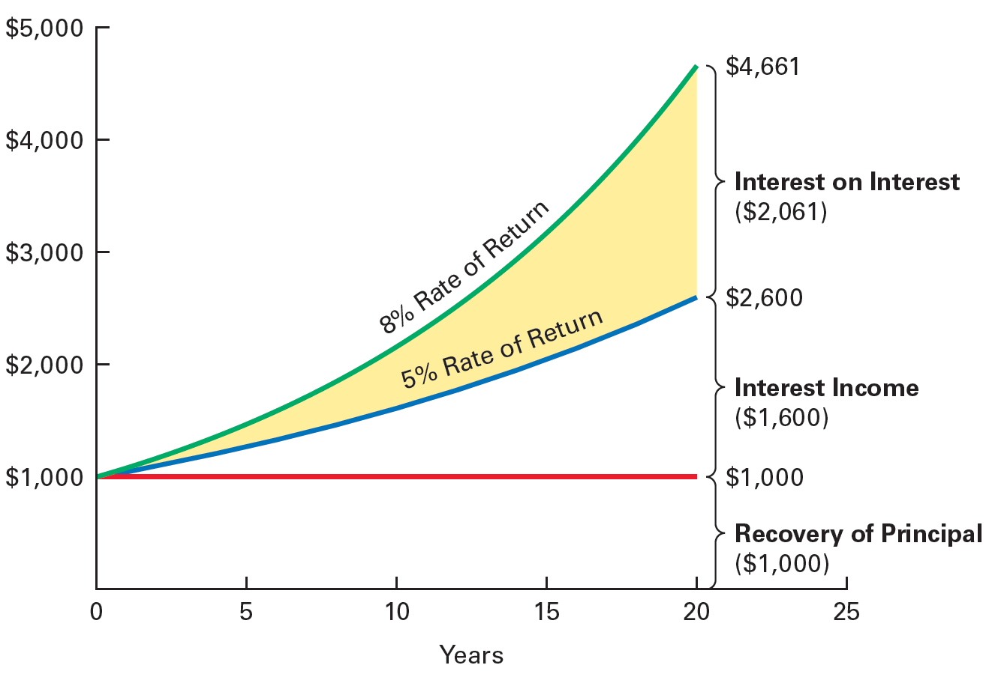
Figure 4.1 Earning Interest on Interest

Slide 33
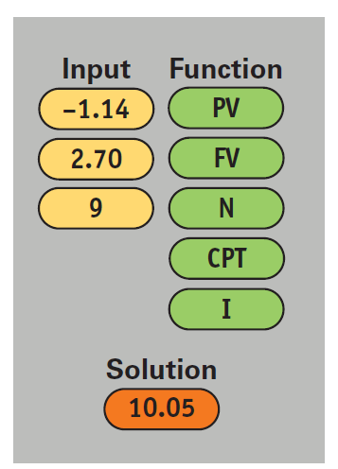
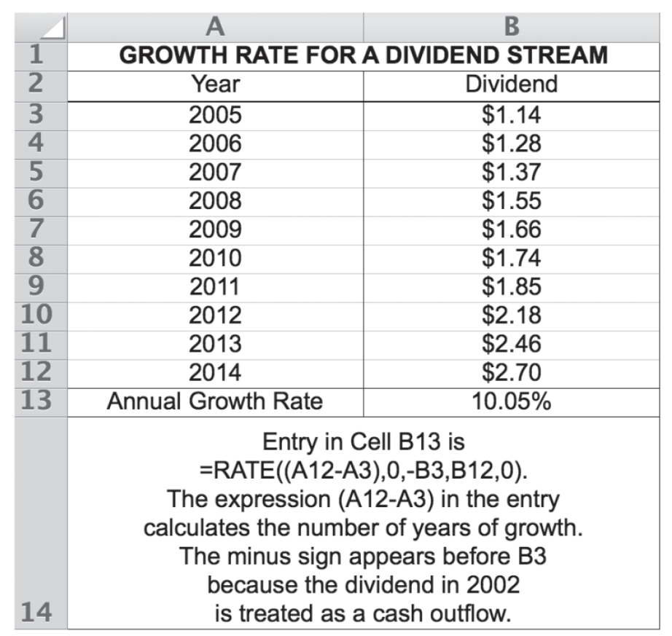
Measuring Return
Finding Growth Rates
Rate of Growth: The compound annual rate of change in some financial quantity, such as the price of a stock or the size of its dividend.
Growth Rate Example:
Reference Exxon’s dividends from Table 4.3, shown earlier

Slide 34
Risk: The Other Side of the Coin
Risk: the uncertainty surrounding the actual return that an investment will generate.
Risk-Return Tradeoff: the relationship between risk and return in which investors want to obtain the highest possible return for the level of risk that they are willing to take.
Sources of Risk
The Risk of a Single Asset
Assessing Risk
Steps in the Decision Process: Combining Return and Risk

Slide 35
Risk: The Other Side of the Coin
Sources of Risk
Business Risk: the degree of uncertainty associated with an investment’s earnings and the investment’s ability to pay the returns (interest, principal, dividends) that investors expect.
Tied to a firm’s industry
Generally, investments from similar kinds of firms have similar business risk
Differences in management, costs, and location can cause variation
Financial Risk: the increased uncertainty that results when a firm borrows money.
The more debt used to finance a firm, the greater its financial risk.

Slide 36
Risk: The Other Side of the Coin
Sources of Risk
Purchasing Power Risk: the chance that unanticipated changes in price levels (inflation or deflation) will adversely affect investment returns.
Interest Rate Risk: the chance that changes in interest rates will adversely affect a security’s value.
Liquidity Risk: the risk of not being able to sell (liquidate) an investment quickly without reducing its price.
Tax Risk: The chance that Congress will make unfavorable changes in tax laws, driving down the after-tax returns and market values of certain investments.

Slide 37
Risk: The Other Side of the Coin
Sources of Risk
Event Risk: occurs when an unexpected event has a significant and unusually immediate effect on the underlying value of an investment.
Market Risk: the risk that investment returns will decline because of factors that affect the broader market, not just one company or one investment.
Examples: political, economic, and social events as well as changes in investor tastes and preferences
Actually embodies a number of risks including purchasing power risk, interest rate risk, and tax risk.

Slide 38
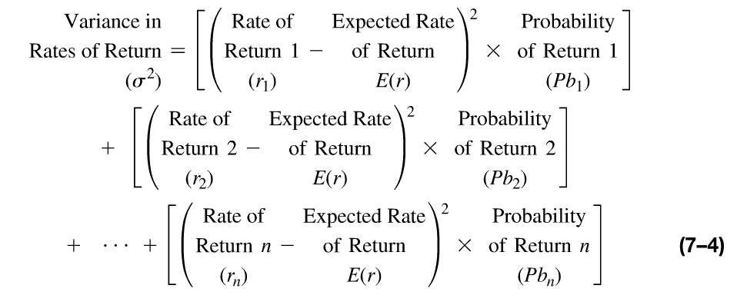
Risk: The Other Side of the Coin
Risk of a Single Asset

Slide 39
Risk: The Other Side of the Coin
Risk of a Single Asset

Slide 40
Risk: The Other Side of the Coin
Risk of a Single Asset
Standard Deviation: An Absolute Measure of Risk
Standard Deviation: An indicator of an asset’s risk, it measure the dispersion (variation) of returns around an asset’s average or expected return.

Slide 41
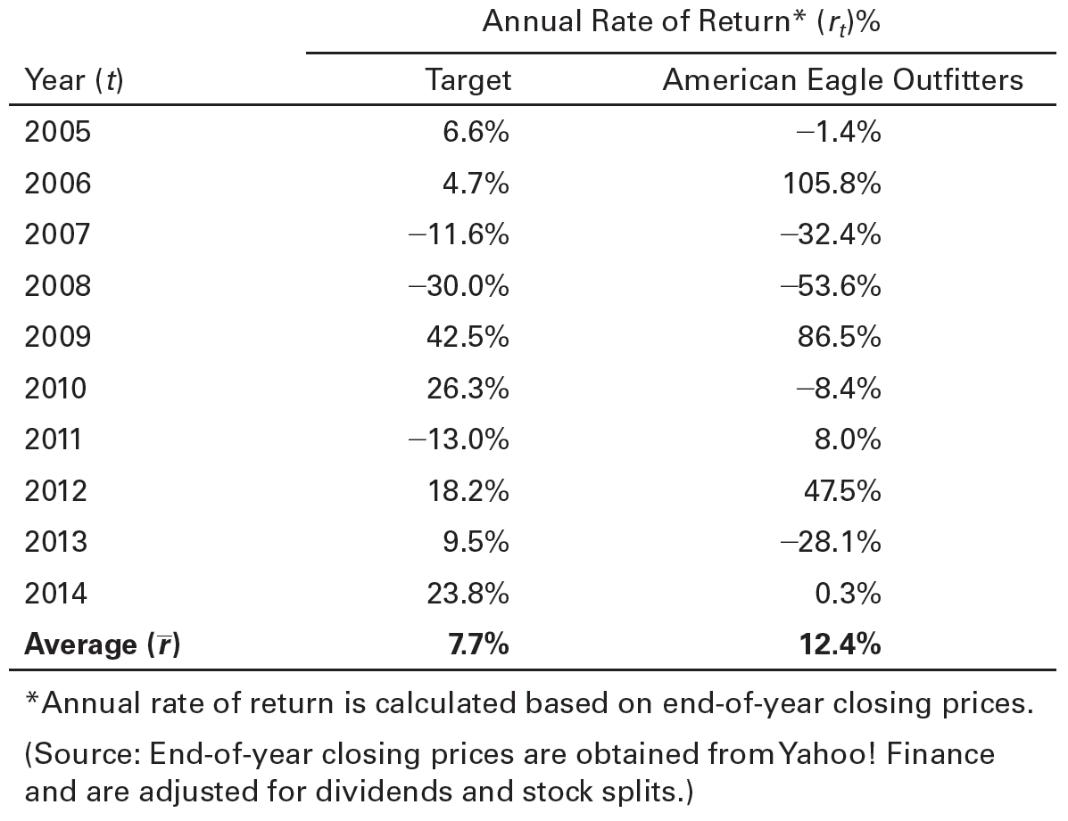
Table 4.8 Historical Annual Returns for Target and American Eagle Outfitters

Slide 42
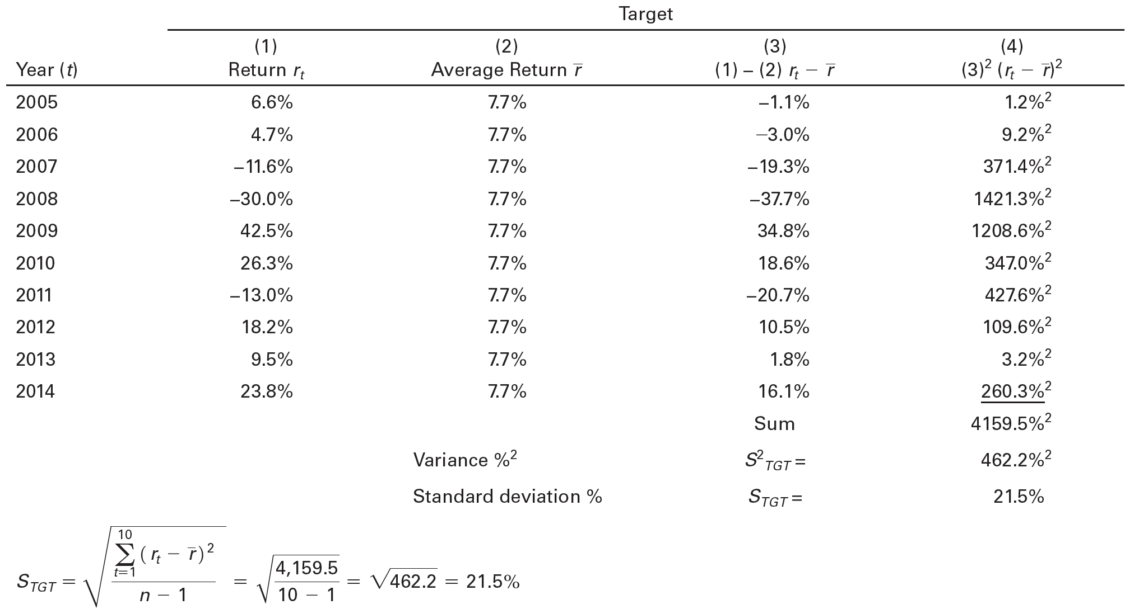
Table 4.9 Calculation of Standard Deviations of Returns for Target and American Eagle Outfitters (1 of 2)

Slide 43
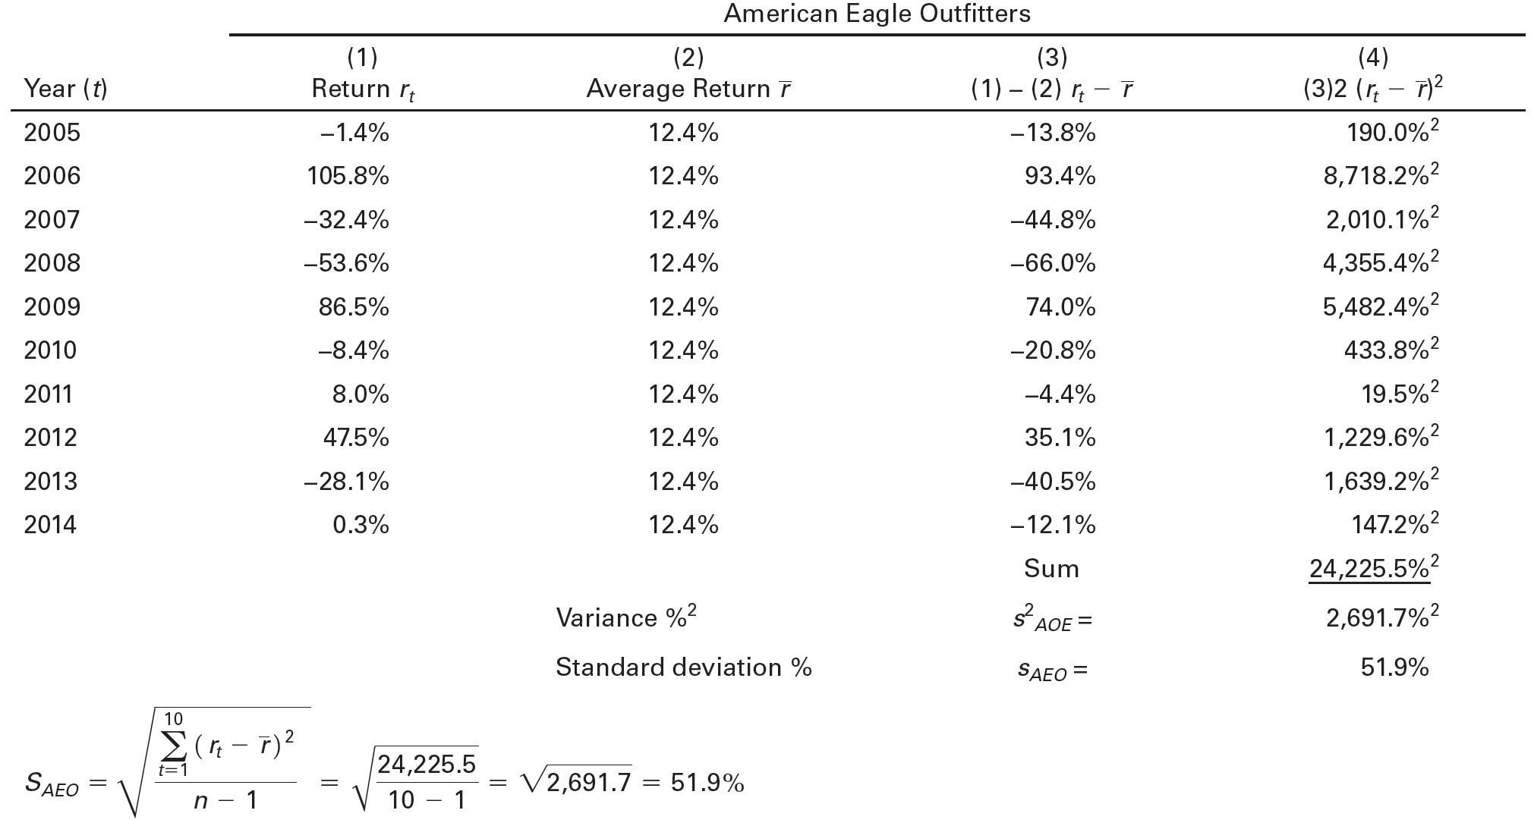
Table 4.9 Calculation of Standard Deviations of Returns for Target and American Eagle Outfitters (2 of 2)

Slide 44
Risk: The Other Side of the Coin
Risk of a Single Asset
Historical Returns and Risk
Standard deviation can be used as a measure of risk to assess historical investment return data
General pattern: Investments with higher average returns have higher standard deviations, reflecting greater risk.

Slide 45
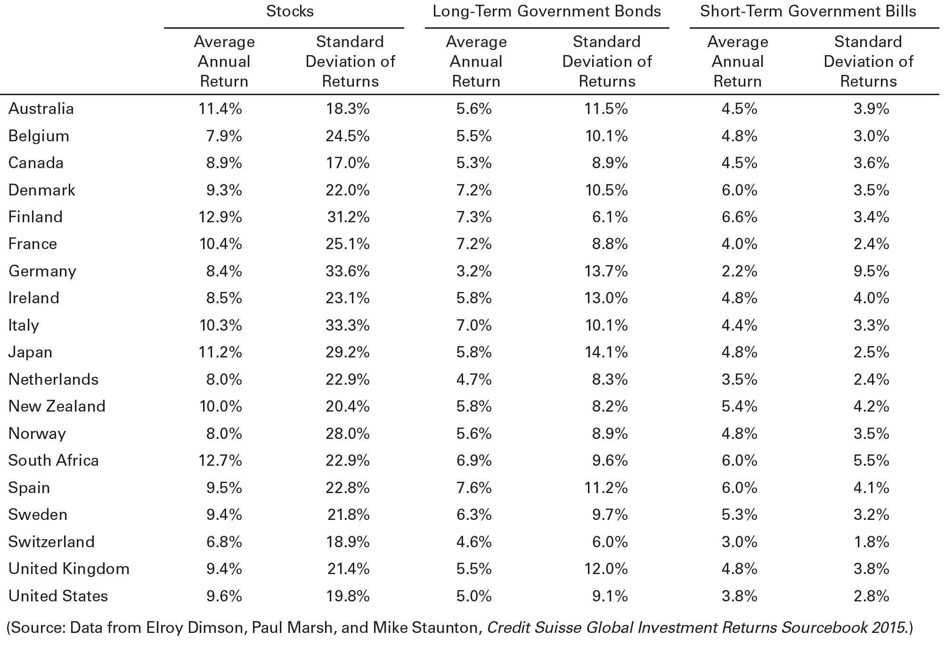
Table 4.10 Historical Returns and Standard Deviations for Select Asset Classes (1900–2014)

Slide 46
Risk: The Other Side of the Coin
Assessing Risk
A look at the general risk-return characteristics of alternative investments and at the question of an acceptable level of risk helps show how to evaluate risk.
Risk-Return Characteristics of Alternative Investments
A risk-return tradeoff exists such that for a higher risk one expects a higher return, and vice versa.
In general, low-risk/low-return investments include U.S. government securities and deposit accounts.
In general, high-risk/high-return investments include real estate and other tangible investments, common stocks, options, and futures.

Slide 47
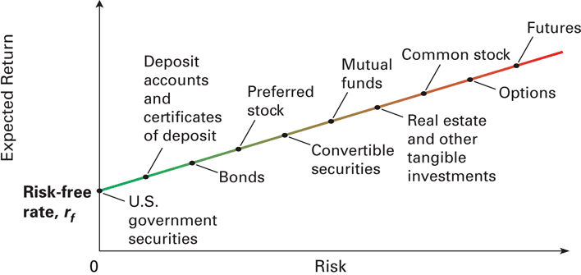
Figure 4.2 Risk-Return Tradeoffs for Various Investments

Slide 48
Risk: The Other Side of the Coin
Assessing Risk
A look at the general risk-return characteristics of alternative investments and at the question of an acceptable level of risk helps show how to evaluate risk.
An Acceptable Level of Risk
Individuals differ in the amount of risk that they are willing to bear and the return they require as compensation for bearing that risk.
Risk-indifferent (risk-neutral): describes an investor who does not require a change in return as compensation for greater risk.
Risk-averse: describes an investor who requires greater return in exchange for greater risk.
Risk-seeking: describes an investor who will accept a lower return in exchange for greater risk.

Slide 49
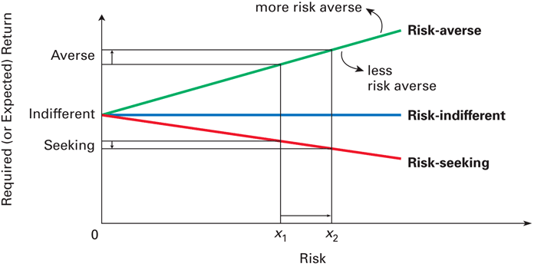
Figure 4.3 Risk Preferences

Slide 50
Risk: The Other Side of the Coin
Steps in the Decision Process: Combining Return and Risk
When you are deciding among alternative investments, you should take the following steps to combine return and risk:
Estimate the expected return using present value methods and historical or projected return data
Assess the risk of the investment by looking at historical/projected returns using standard deviation.
Evaluate the risk-return characteristics of each investment option to make sure the return is reasonable given the level of risk.
Select the investments that offer the highest expected returns associated with the level of risk you are willing to accept.

Slide 51
Chapter 4 Review Learning Goals
Review the concept of return, its components, the forces that affect the level of return, and historical returns.
Discuss the role of time value of money in measuring return and defining a satisfactory investment.
Describe real, risk-free, and required returns and the calculation and application of holding period return.
Explain the concept and calculation of an internal rate of return and how to find growth rates.
Discuss the key sources of risk that might affect potential investments.
Understand the risk of a single asset, risk assessment, and the steps that combine return and risk.

Slide 52
Practice Questions

Slide 53
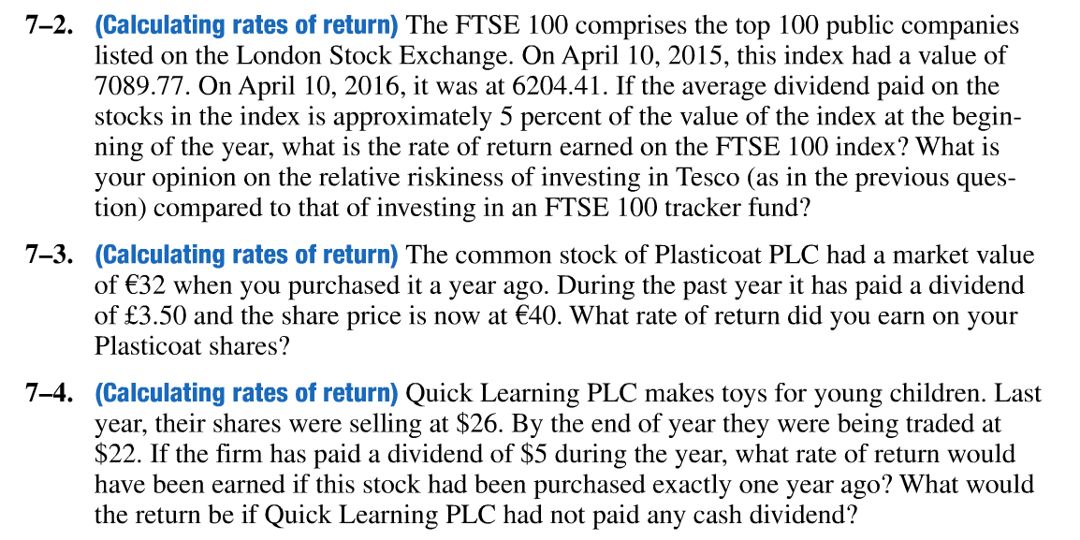
Practice Questions

Slide 54
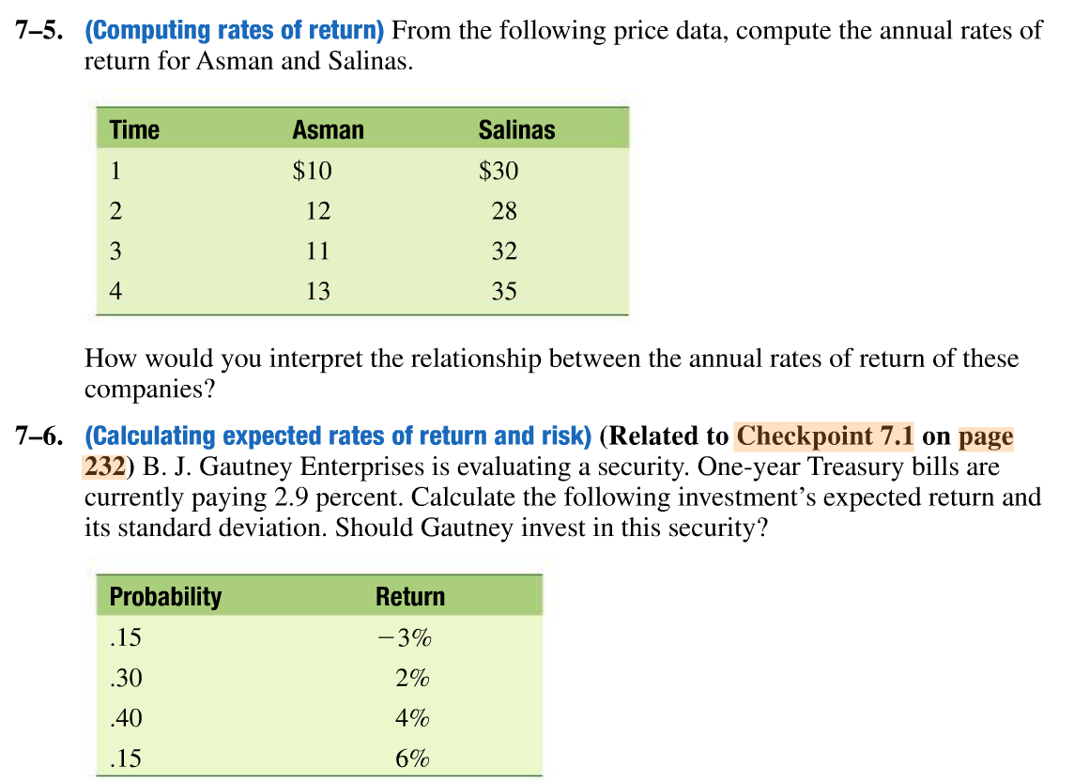
Practice Questions

Slide 55
Practice Questions

Slide 56
Thank You

